Slide 1


Unit 1
HHFA training tools
Notes:
Welcome to Unit 1 of Module 7.

Slide 2
By the end of this unit, you will be able to:
list the tools available to facilitators to conduct data collection training
describe how to use the different tools available for training
Notes:
By the end of this unit, you will be able to
list the tools available to facilitators to conduct data collection training;
describe how to use the different tools available for training.

Slide 3
Tools for training
There are 8 tools available to facilitators to conduct data collection training:
1
Questionnaire
5
Sessions
2
Agenda
6
Reference manual
3
Facilitator’s guide
7
Final training test
4
8
Daily and end-of-training evaluation
Summary tables
Notes:
There are 8 tools available to facilitators to conduct data collection training:
Questionnaire;
Agenda;
Facilitator’s guide;
Summary tables;
Sessions;
Reference manual;
Final training test;
Daily and end-of-training evaluation.
We’ll now look at each tool in more detail.

Slide 4

1. Questionnaire
The questionnaire is the focus of the training.
By the time the facilitators start training, the questionnaire should:
have been adapted to country needs
be accessible to participants and facilitators
Notes:
The questionnaire is the instrument that data collectors will use to collect information, and therefore the focus of the training.
By the time the facilitators start training, the questionnaire should already have been adapted to the country needs.
The questionnaire should be accessible at all times to participants and facilitators.

Slide 5
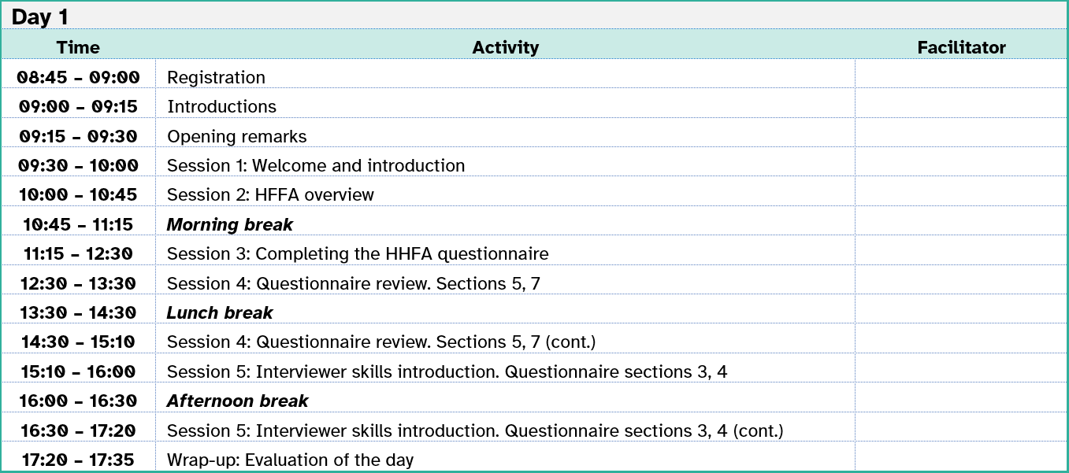
2. Agenda
A suggested 10-day agenda for the data collection training is available as a:
stand-alone document in the training package
chapter in the facilitator’s guide
The agenda should be used to understand how the training schedule is organized.
Notes:
A suggested 10-day agenda for the data collection training is available as a:
stand-alone document in the training package; and a
chapter in the Facilitator’s guide.
The agenda should be used to understand how the training schedule is organized.

Slide 6

3. Facilitator’s guide
The Facilitator’s guide provides guidance on the:
organization of the training
facilitation of the different sessions
Notes:
The Facilitator’s guide provides guidance on the:
organization of the training; and the
facilitation of the different sessions.

Slide 7
3. Facilitator’s guide
The guide should be used to:
prepare the training agenda
support training preparation
facilitate the sessions
Notes:
Therefore, the guide should be used by facilitators to:
prepare the training agenda;
support training preparation; and
properly facilitate each of the sessions.

Slide 8
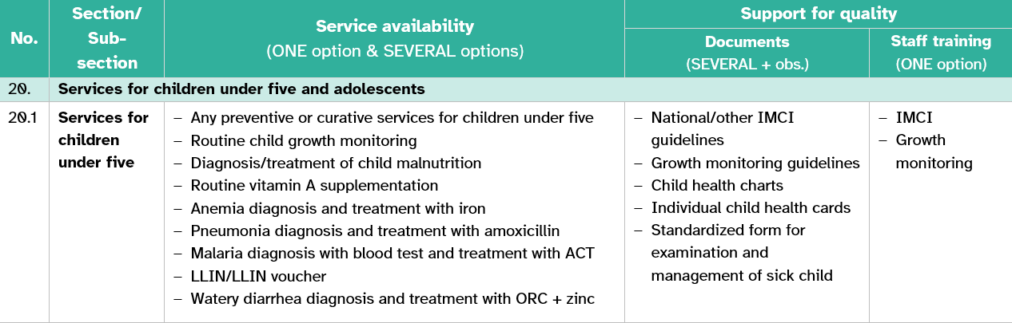
4. Summary tables
Summary tables provide facilitators and participants with a snapshot visualization of the technical content in sections/sub-sections.
Notes:
Summary tables provide facilitators and participants with a snapshot visualization of all the technical content in sections/sub-sections.
For example, this summary table shows the sub-section on services for children under 5. The table columns represent the categories of information in the section or sub-section.

Slide 9
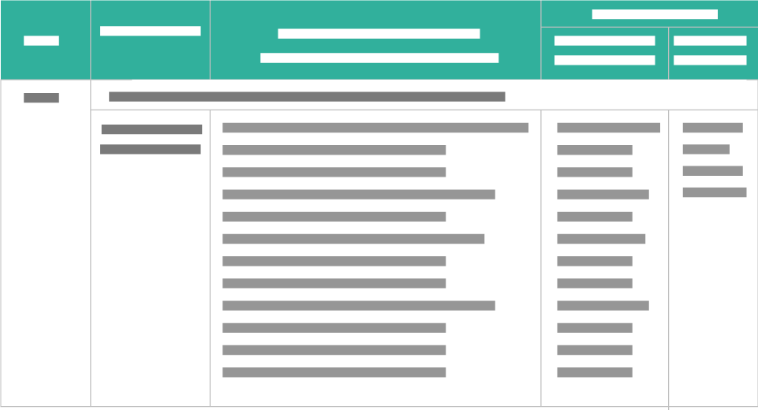
4. Summary tables
The training package includes tables summarizing content from the readiness sections 13 to 31.
Summary tables help participants:
visualize
summarize
review
Notes:
The training package includes tables summarizing all the content from the readiness sections 13 to 31.
Summary tables should be used by facilitators to help participants:
visualize;
summarize; and
review;
the technical content in the readiness sections of the questionnaire.

Slide 10
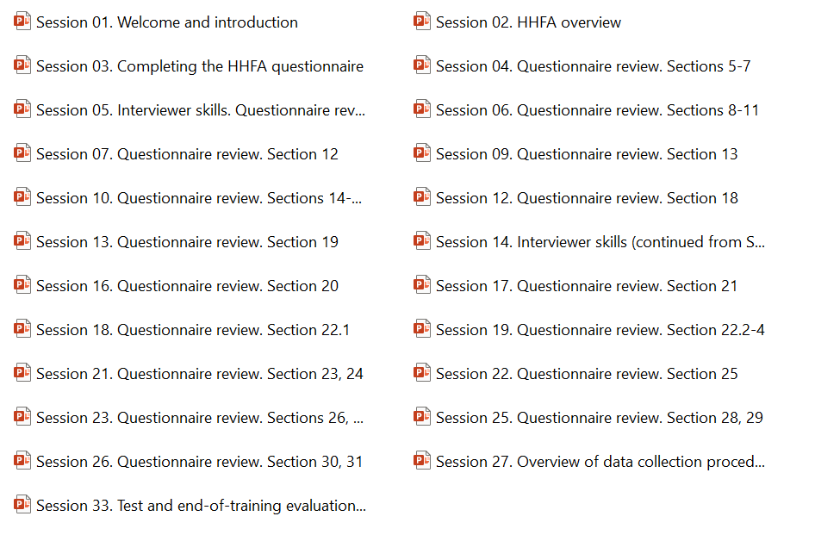
5. Sessions
The data collection training package includes 37 sessions.
Most training sessions are facilitated through PowerPoint presentations.
Facilitators should review the sessions jointly with the guidance provided
in the Facilitator’s guide and the questionnaire.
Notes:
The data collection training package includes a folder of 37 sessions.
With a few exceptions, most of the training sessions are facilitated through PowerPoint presentations.
Facilitators should always review the sessions jointly with the specific guidance for the sessions provided in the Facilitator’s guide and the questionnaire.

Slide 11

6. Reference manual
A Reference manual for data collection provides specific guidance on the HHFA questions.
It should be used:
in advance of the training (by facilitators)
during the training (by all)
during data collection (by data collectors)
Notes:
A Reference manual for data collection provides specific guidance on the HHFA questions through details that help to collect accurate data.
Facilitators should review this manual in advance of the training to obtain additional details for the content of the sessions they will be facilitating.
Facilitators and participants alike should consult this tool during training if there are doubts about how to collect data on any particular question or questionnaire section.
Likewise, data collectors should consult this tool during data collection when in doubt.

Slide 12
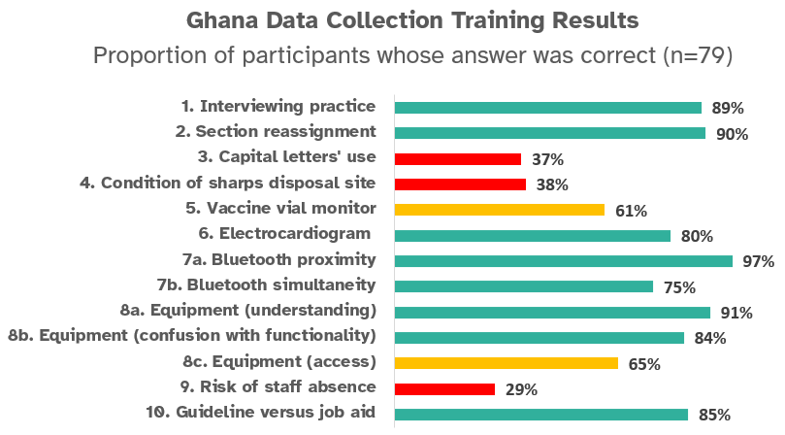
7. Final training test
Countries may want to test the knowledge that participants acquired during the training to help select the final pool of data collectors and team leaders.
The test should be adapted to the country needs and context.
Notes:
Countries may want to test the knowledge that participants acquired during the training to help select the final pool of data collectors and team leaders.
The test should be adapted to the country needs and context.

Slide 13



7. Final training test
To support the process, the training package contains:
a menu of possible test questions
an example of a results analysis
an example of how to share the test results
Notes:
To support the process, the training package contains:
a menu of possible test questions (including answer key) in Word format;
an example of a results analysis, if the test is administered electronically, in Excel format; and
an example of how to share the test results in a PowerPoint.

Slide 14
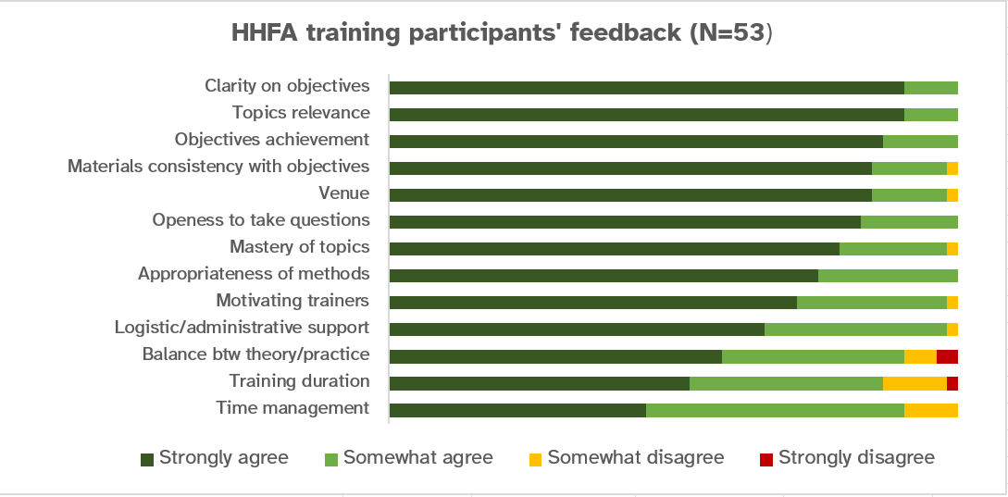
8. Daily and end-of-training evaluation
The training package includes the option to obtain participants’ feedback through daily and end-of-training evaluations.
The evaluation forms are available online.
Notes:
The training package includes the option to obtain participants’ feedback on the training through daily and end-of-training evaluations.
The evaluation forms are available online through a survey administration software.

Slide 15

8. Daily and end-of-training evaluation
To obtain participants’ feedback, the training package contains:
paper and online forms
example of analysis of evaluation responses
example of how to share findings with participants
Notes:
To obtain participants’ feedback, the training package contains:
paper and online forms;
an example of analysis of evaluation responses, in Excel format; and
an example of how to share findings with participants, in PowerPoint format.

Slide 16
You have now completed Unit 1.
In the next unit, we will look at how to prepare for HHFA training sessions that you might be assigned to facilitate.
Notes:
You have now completed Unit 1.
In the next unit, we will look at how to prepare for HHFA training sessions that you might be assigned to facilitate.

